Slide 1
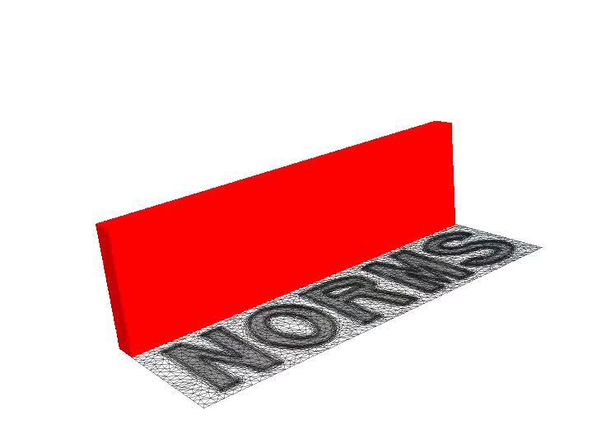

Pathways Towards Unstructured Mesh Adaptivity for Reservoir Modelling
James Percival, Pablo Salinas, Dimitrios Pavlidis, Zhihua Xie,
Chris Pain, Matthew Jackson
Applied Modelling and Computation Group
Novel Reservoir Modelling and Simulation Group
Presentation to NORMS
12th November 2014

Slide 2
Outline
Background (What is Mesh Adaptivity?)
Motivation (Why Adapt Meshes?)
Current Methodology (How does IC-FERST adapt meshes?)
Discussion (How to be better?)

Slide 3
Background – The goals of numerical simulation
In numerical simulation there are 3 key concerns:
Accuracy – simulation is a good representation of real behaviour of the system
Stability – answers remain physically relevant.
Cost – Time/expense of generating solution
Often imposssible to achieve all of fast, accurate & robust.
Increase dissipation
Increase
resolution
Use lower order method

Slide 4
Background – Why discretize?
Computers (& humans) have
finite memories
PDEs contain information at infinite no. of scales
Physics in PDEs converted
into linear algebra via a choice
of discretization
Finite difference
Finite Volume
Spectral Methods
Finite element
Mesh Free methods
Notice!
Different discretization methods often combined.
 | Integer | Floating point
16 bit | -32,768 to 32,767
32 bit | −2,147,483,648 to +2,147,483,647 | ±1.4 x10-45 to 3.4 x10³⁸ (~7.2 sig. fig)
64 bit | −9,223,372,036,854,775,808 to +9,223,372,036,854,775,807 | 10⁻³⁰⁸ to 10³⁰⁸ ( 16 sig. fig)
Page 4

Slide 5
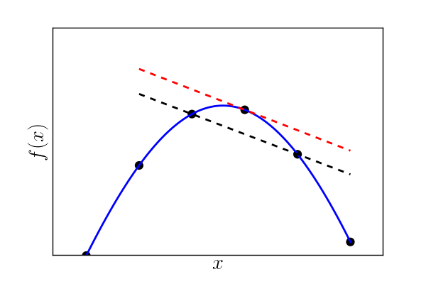
Background – Finite Differences
Finite differences – Schoolboy calculus
Notice!
Implementation is usually simpler (& more accurate) on structured uniform meshes

Slide 6
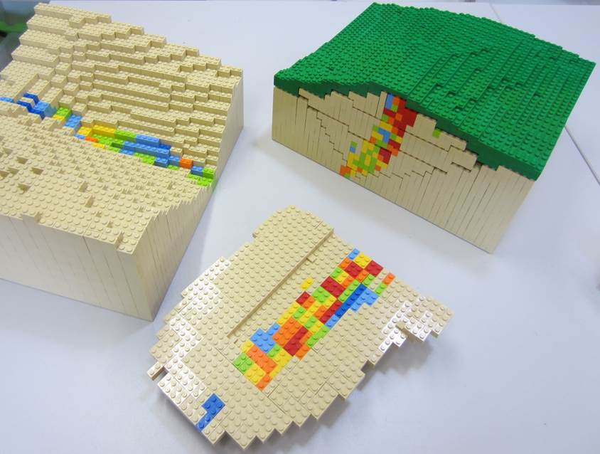
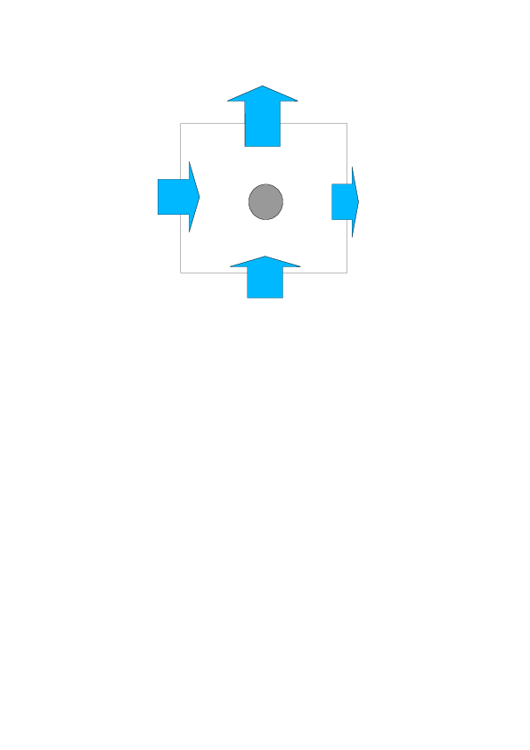
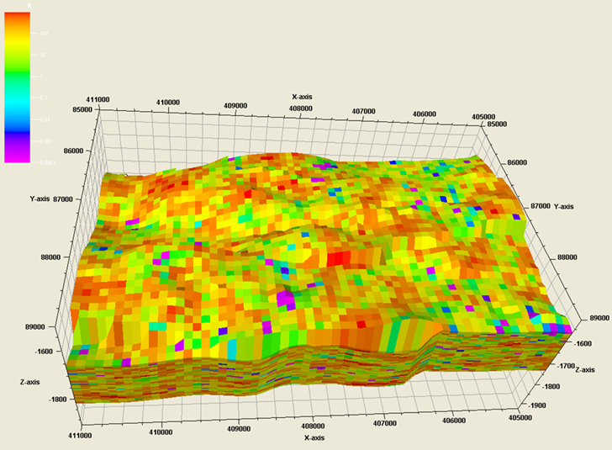
Background – Finite Volumes
“Lego science”
Bonus!
Ensures local conservation for (almost) free
Notice!
Needs coupling to alternative method
for derivatives

Slide 7
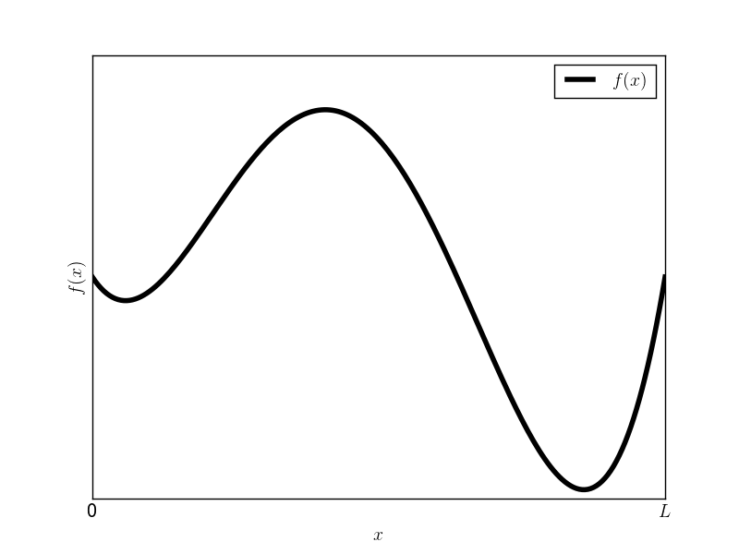
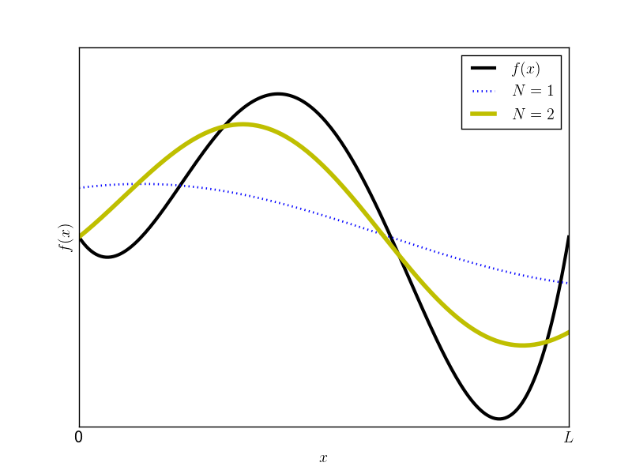
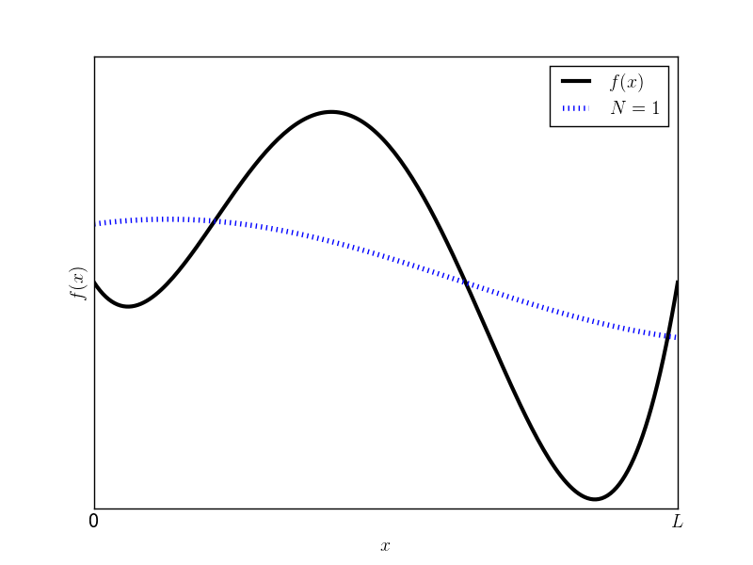
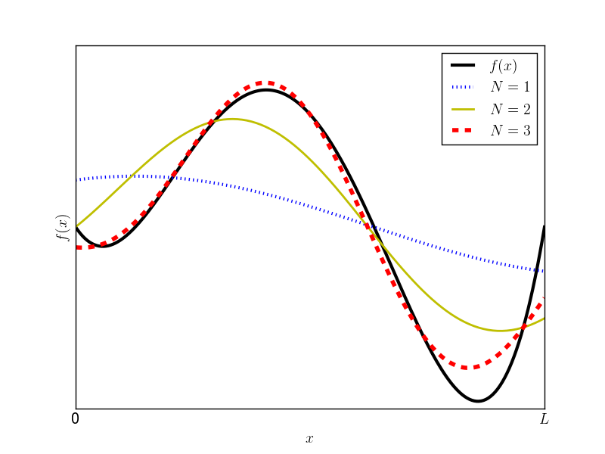
Background – Spectral Methods
Spectral methods – basis functions
Notice!
Doesn’t much like boundary conditions or complex geometries

Slide 8
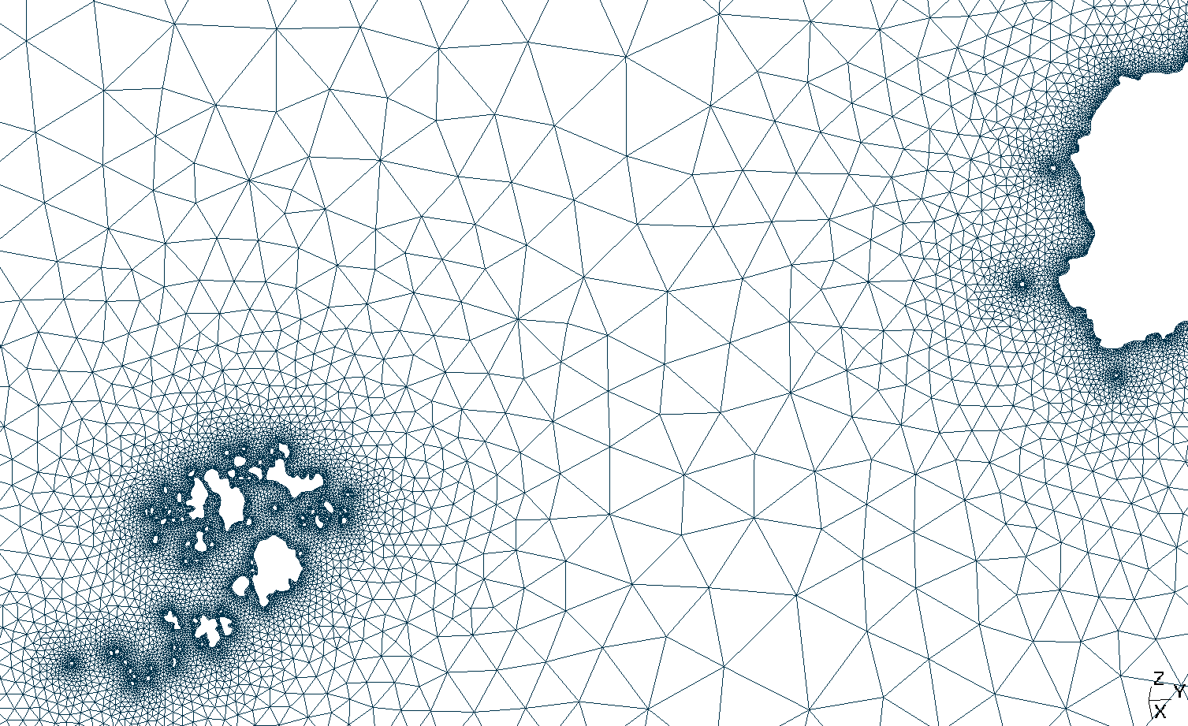
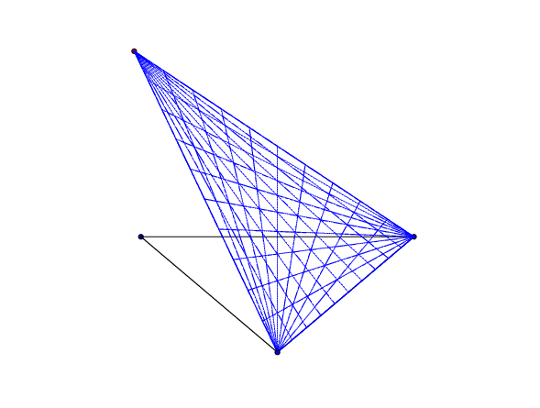
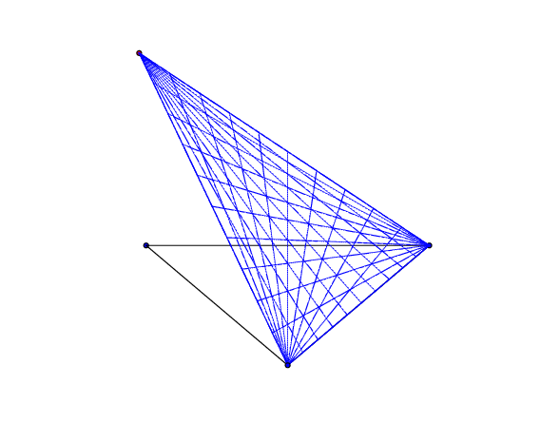
Background – Finite Elements
Couple basis functions
+ partition into simple shapes
Warning!
Lots of maths being skipped
(weak forms, test functions, etc.)

Slide 9
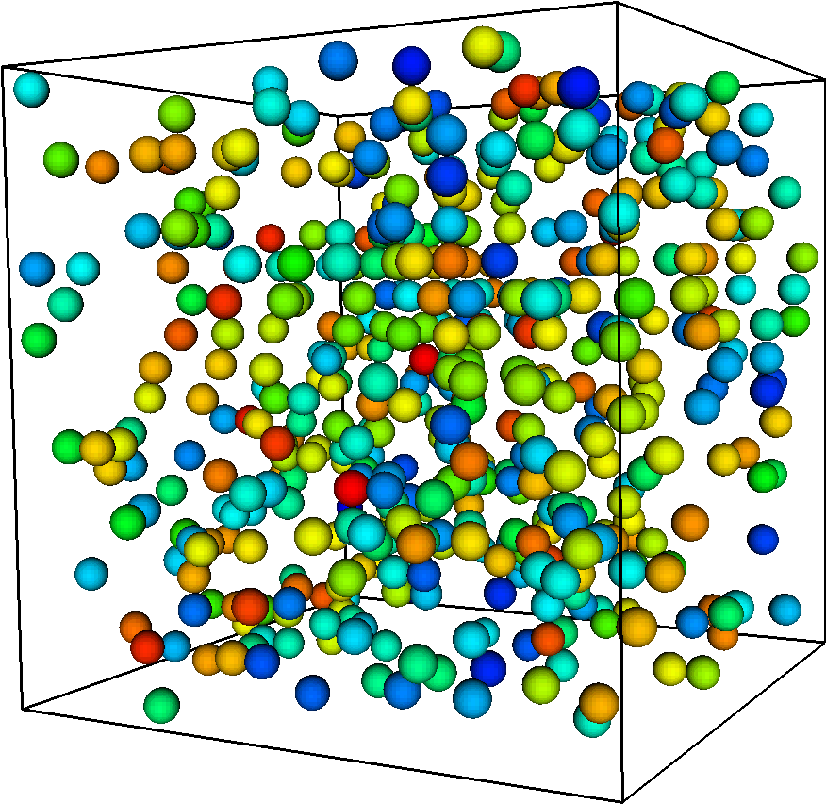
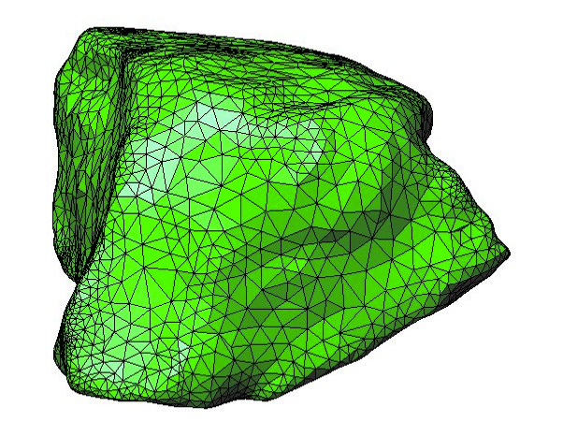
FEM
Background - Mesh Free Methods - DEM
+
DEM
Notice!
Slides from (and questions to)
Jiansheng Xiang

Slide 10
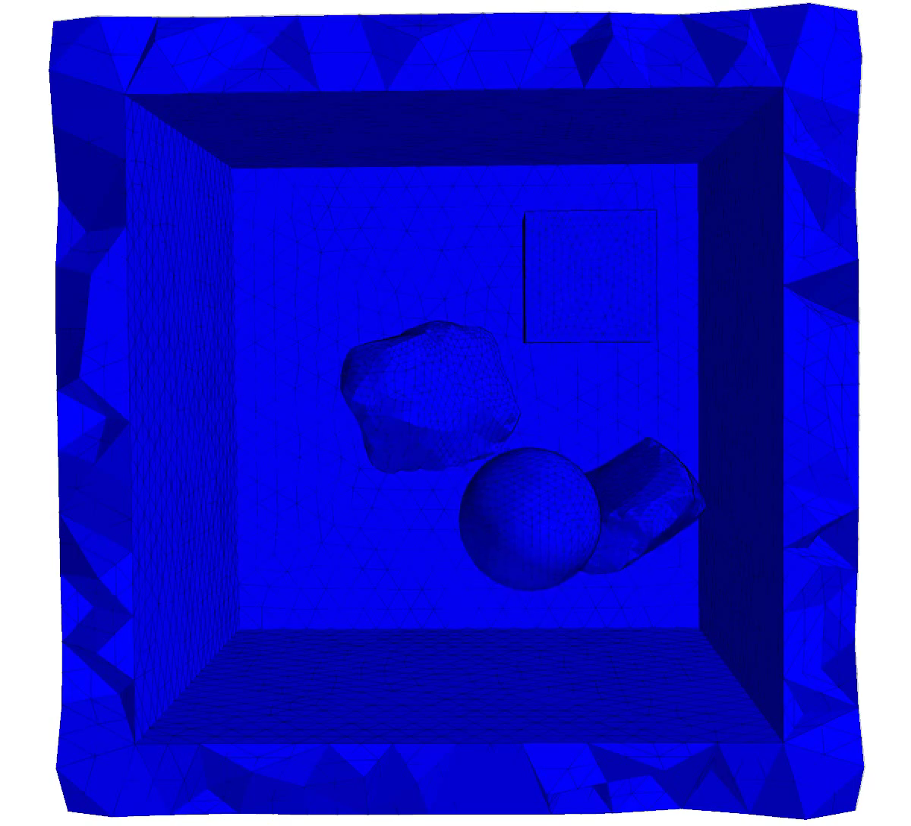
What is FEMDEM?
Website:
http://www.vgest.net
Xiang, J. et al. 2009. Finite strain, finite rotation quadratic tetrahedral element for the combined finite-discrete element method. Int Journal for Numerical Methods in Engineering DOI:10.1002/nme.2599
Notes:
10

Slide 11
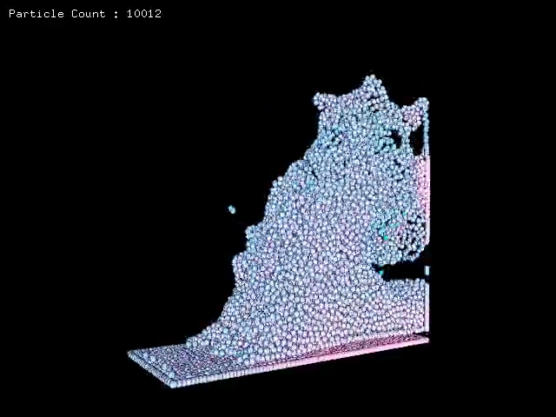
Mesh Free Methods
Smoothed Particle Hydrodynamics (SPH)
Slide
from
Youtube
M. Müller

Slide 12
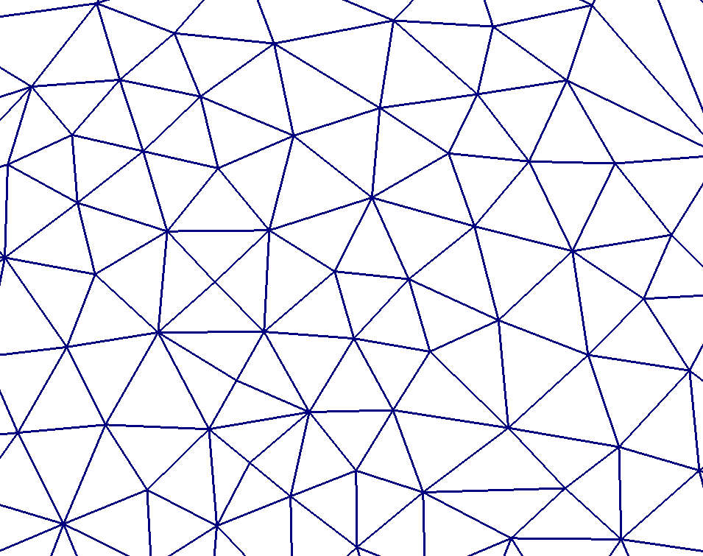
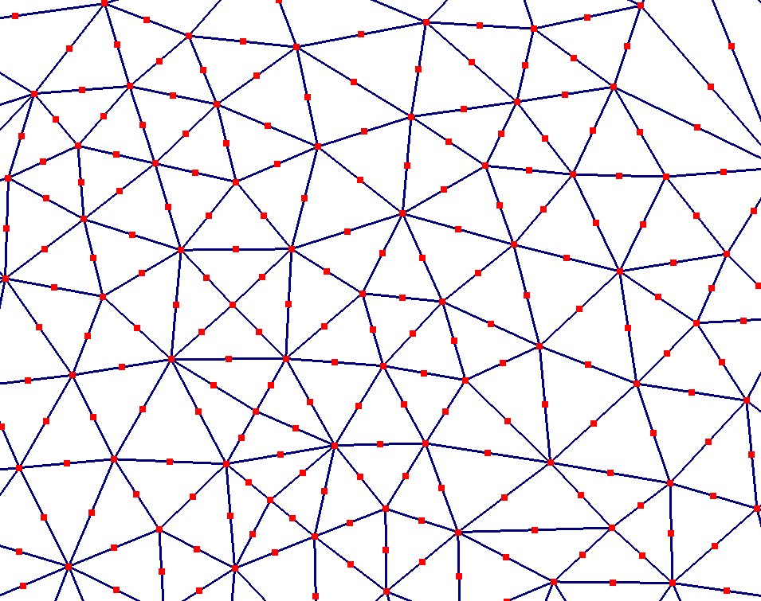
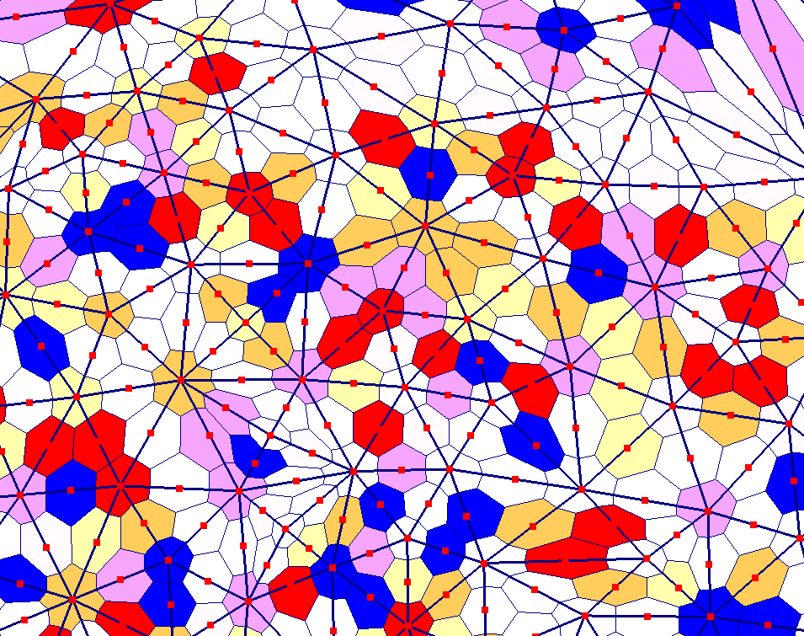
Background – Hybrid Methods
Methods combined.
Eg. Finite Element Method+ Discrete Element Method = FEMDEM
Control volumes: - Just finite volumes piggybacking on finite elements
Voronoi dual mesh
Control volumes
Finite Element Mesh
Finite element “nodes”

Slide 13
Motivation – Meshes & Grids
Meshs/grids are ubiquitous
in computational science
Discretization imposes length
scale on the problem
Trade-off: high resolution
discretizations often more
accurate, but take more
time to simulate
Idea: Only put high
resolution “where
it needs to be”
dynamically.
Warning!
Smaller spatial grid implies smaller timesteps
Page 13

Slide 14
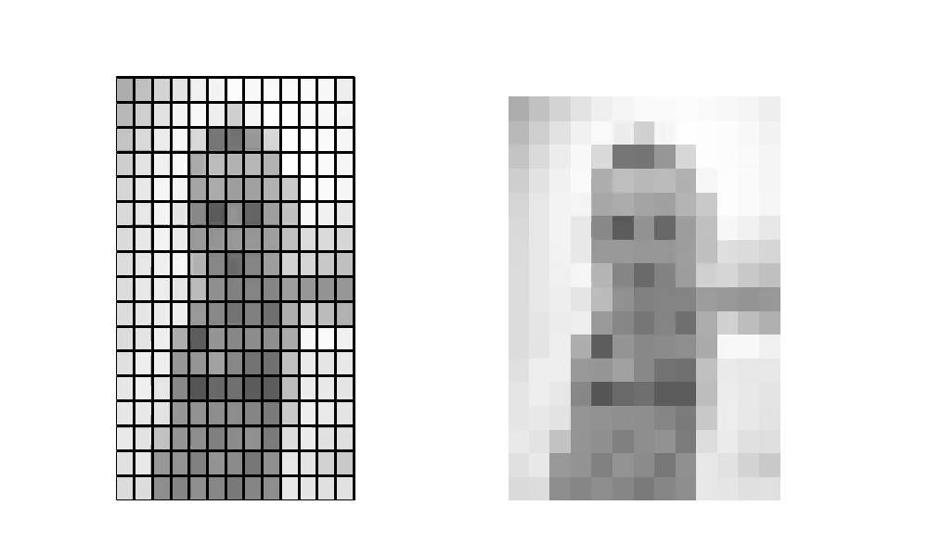
Motivation - AMR
Idea has been applied on structured meshes:
Adaptive Mesh Refinement (AMR)
Notice!
The video is created by hand, coarsening the high res photo. No algorithm.
Page 14

Slide 15
Motivation - AMR
Adaptive Mesh Refinement:
Refinement forms a tree:
Cell BB02 is in cell cγ is in Cell C6
Convenient for implementation
Less good for physics
Lots of wasted resolution (especially in 3D)
Can only coarsen on predefined scales
Factors of 2 everywhere.
Page 15

Slide 16
Motivation/Methodology
Fluidity uses unstructured meshes. Can we do better?
Page 16

Slide 17
Motivation/Methodology
Yes:
Fewer wasted regions of high resolution
Not forced to preserve initial orientation or grid lengths
Length scales can differ along/across structures (anisotropy)
Fewer factors of 2.
Page 17

Slide 18
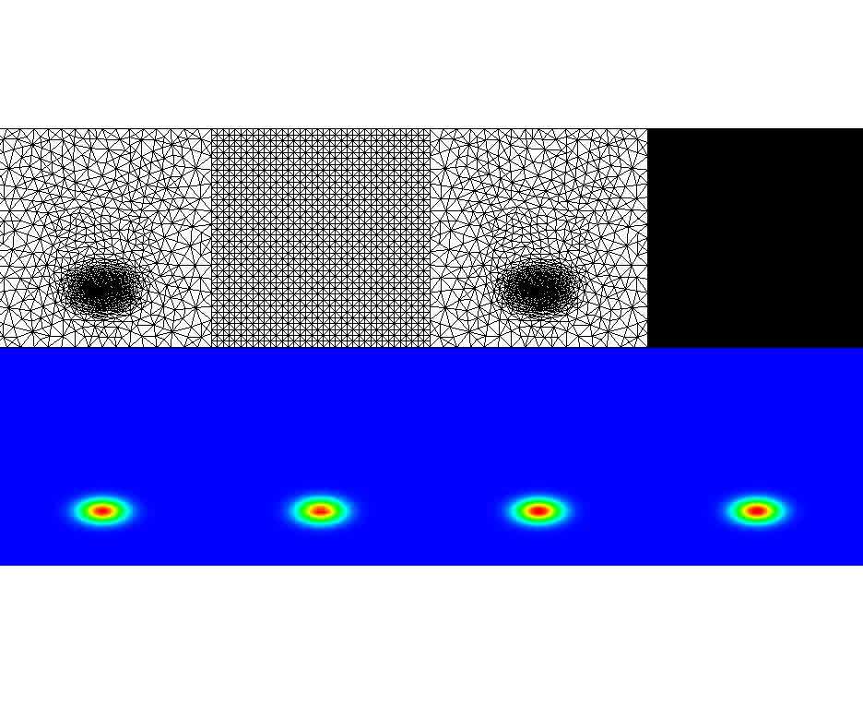
Methodology – An example of Mesh Adaptivity
Advection of a Gaussian bubble
Initial adaptive
mesh
Fixed
mesh 1
Adaptive
mesh
Fixed
mesh 2
Notice!
Don’t adapt every timestep (dispersive & expensive), do it every 10-100 timesteps.
Analytic
solution
Fixed
mesh 1
Adaptive
mesh
Fixed
mesh 2

Slide 19
Mesh Adaptivity: Faster & more accurate solutions
2 orders of magnitude smaller problem/half error
30x speed up
1
Notice!
Unstructured meshes are slower than structured for given size.
Adaptivity is important
0.1
0.01
1000
10000
100000

Slide 20
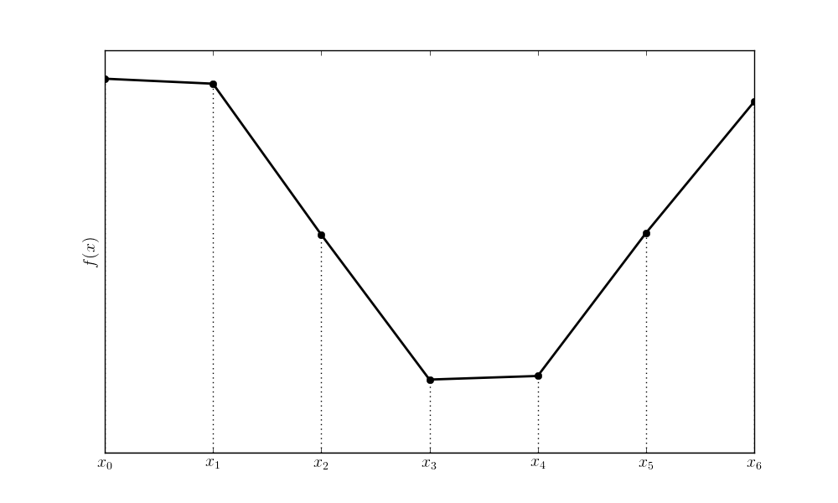
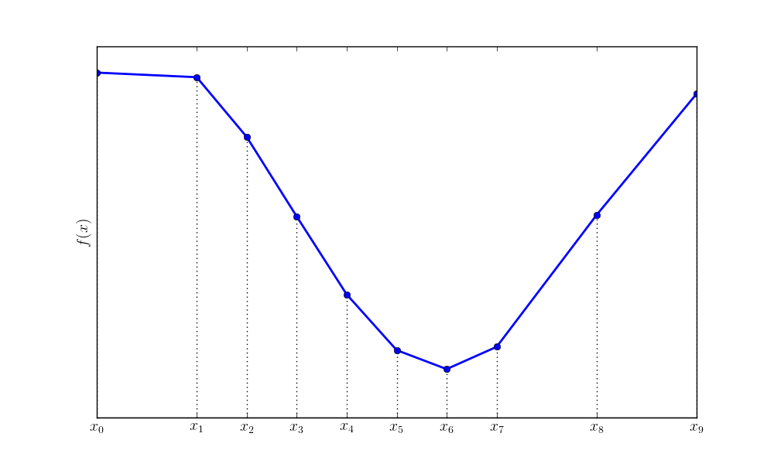
Current Methodology – h adaptivity
h – for step length
like delta x in
finite difference notation
Just like AMR for elements

Slide 21
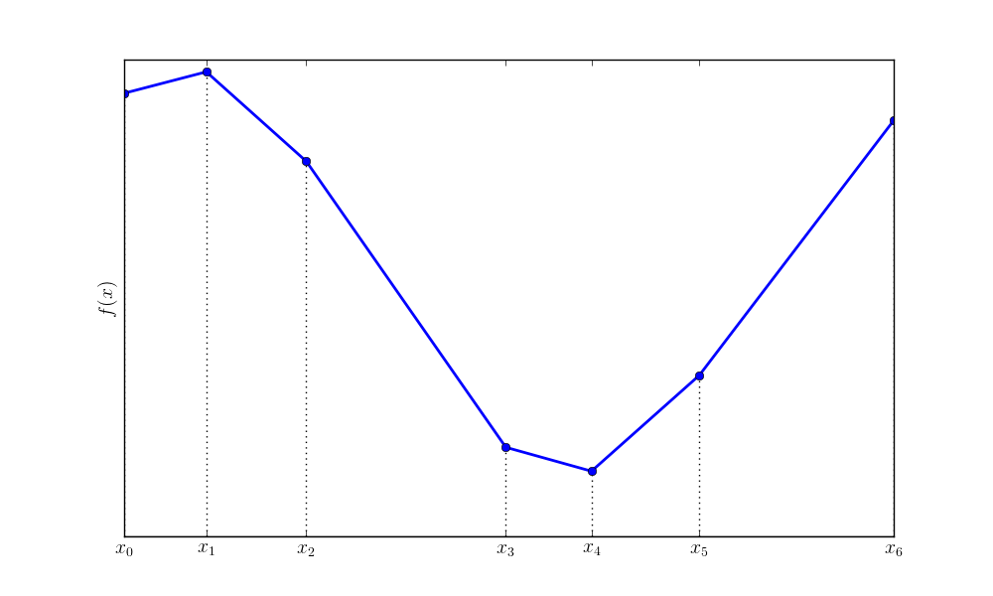
Current Methodology – r adaptivity
r for
redistricution/
repositioning

Slide 22
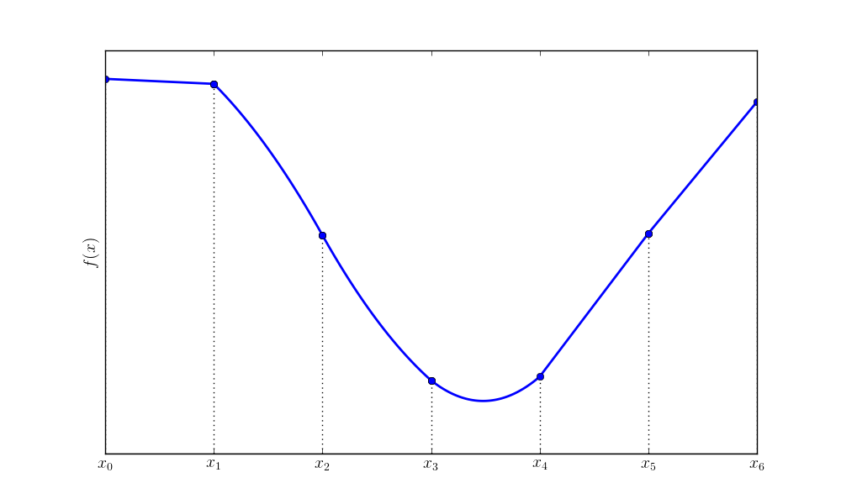
Current Methodology – p adaptivity
p - adaptivity
Warning!
We don’t currently do this
P for polynomial
order

Slide 23
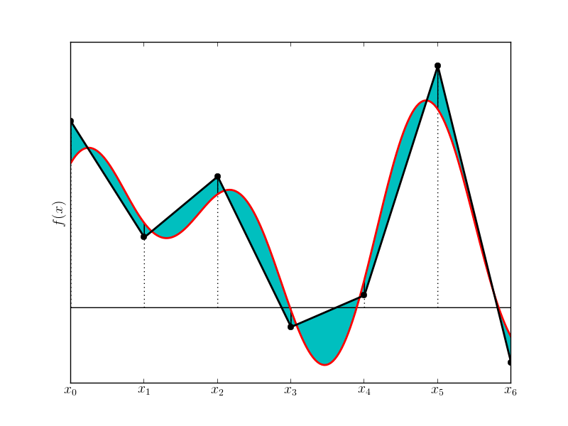
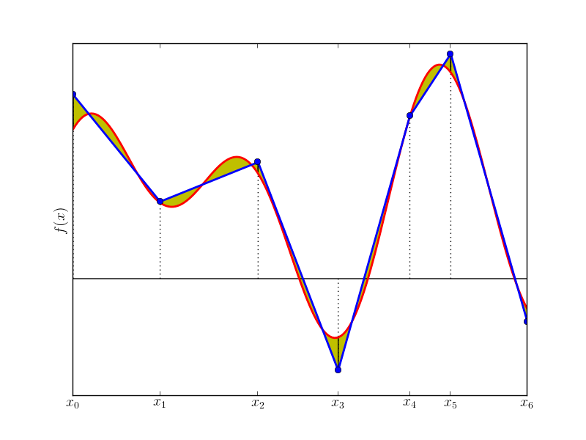
Current Methodology – Error estimates
Motivation: Céa’s Lemma
For sufficiently nice PDEs and linear (or better) elements
Notice!
Haven’t said anything about constant C
Page 23

Slide 24
Current Methodology – Interpolation error estimates
Plotting a linear function with areas of high curvature coloured red
Places where a linear approximation is bad.

Slide 25
Current Methodology – Interpolation error estimates
In higher dimensions, error estimate is a function of the Hessian
and the edge vectors.
The vs are the edges of the mesh
“Mesh metric”

Slide 26
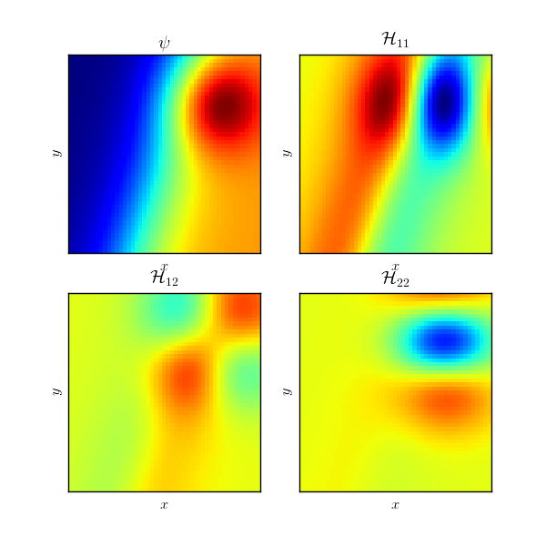
Current Methodology – Interpolation error estimates
Pick out areas of curvature in physical space or in value.
Anistropic:
Allowable scales along a front larger than acrros it.

Slide 27
Current Methodology – Interpolation Error Estimates
Problem: we don’t know ψ^{exact}
Answer: Use ψ^{δ} instead.
Estimate second derivatives from the finite element data
Need a signal present in the data before we can adapt to it
Try to extremize
The vs are the edges of the mesh

Slide 28
Current Methodology – Optimization
Two possibilies once metric is calculated:
Global remeshing: “Slash and burn” Delete old mesh structure and create new mesh from blank sheet of paper
Local remeshing: “Patch and fix” Preserve the old mesh in regions where it is adequate
IC-FERST impliments the second option.
Advatanges in speed, data retention and parallelism
Apply hr adaptivity in the regions where fixing is necessary: Add, remove nodes, reconnect nodes and move nodes.
Pain et al. 2001
Piggott et al 2009

Slide 29
Mesh metrics - Metric Advection
Adaptivity algorithm attemps to minimize error for given data at given time level.
Want a mesh that remains good in the future too.
For advection dominated problems, treat metric as another advected quantity.
Extremise for

Slide 30
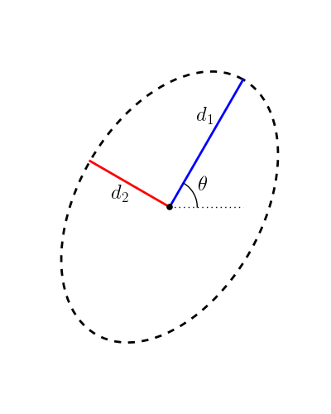
Mesh metrics – bounding edge length
Usually have constraints on:
Minimum edge length [cost]
Maximum edge length [accuracy]
Simple – do surgery on specified metric
after it’s calculated

Slide 31
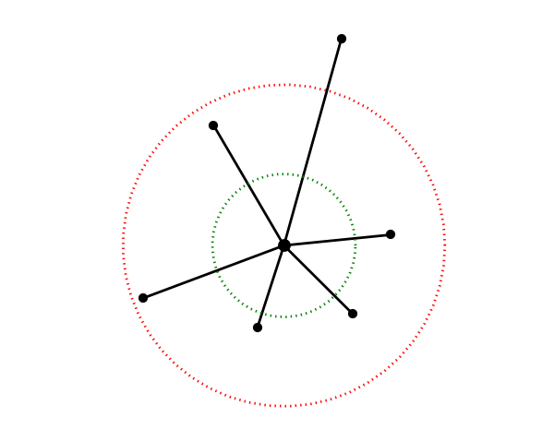
Mesh metrics - Gradation
Often a bad idea to have length scales changing very rapidly between neighbouring elements. (conditioning)
Post-processing of M can enforce smooth increases in the metric away from minima:
Isotropic
Anisotropic

Slide 32


Mesh Metrics - Other knobs and levers
Aspect ratio –like gradation, but edges of a single element
“Fixed” surfaces

Slide 33
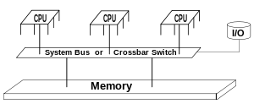
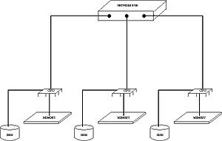
Mesh – Metrics – Aside on parallelism
Shared Memory
Distributed Memory
Multiple processors shared memory (RAM/Hard disk etc)
Threading
“Painting a wall/Piano duet”
Multiple systems each have their own RAM/hard disk and communicate over a LAN.
“Filming a movie
Communication fast, but hard to scale
Not currently implemented in IC-FERST but in use in single-phase Fluidity
Scales well, but communication is slow.
Implimented and under testing in IC-FERST

Slide 34
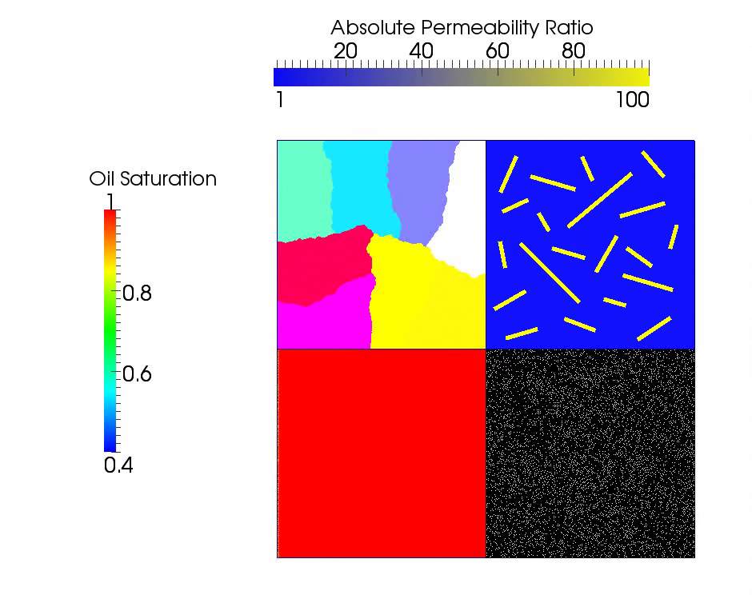
Mesh Metrics - Parallel
IC FERST uses distributed
memory paradigm for parallelism.
Each process acts independently and
communicates information as needed.
For adaptivity this means locking boundary nodes to other processes, then adapting the rest of the domain as in serial.
Once new mesh is found, nodes are redistributed (hopefully shifting the ownership boundaries)
This loop is then repeated several times.

Slide 35
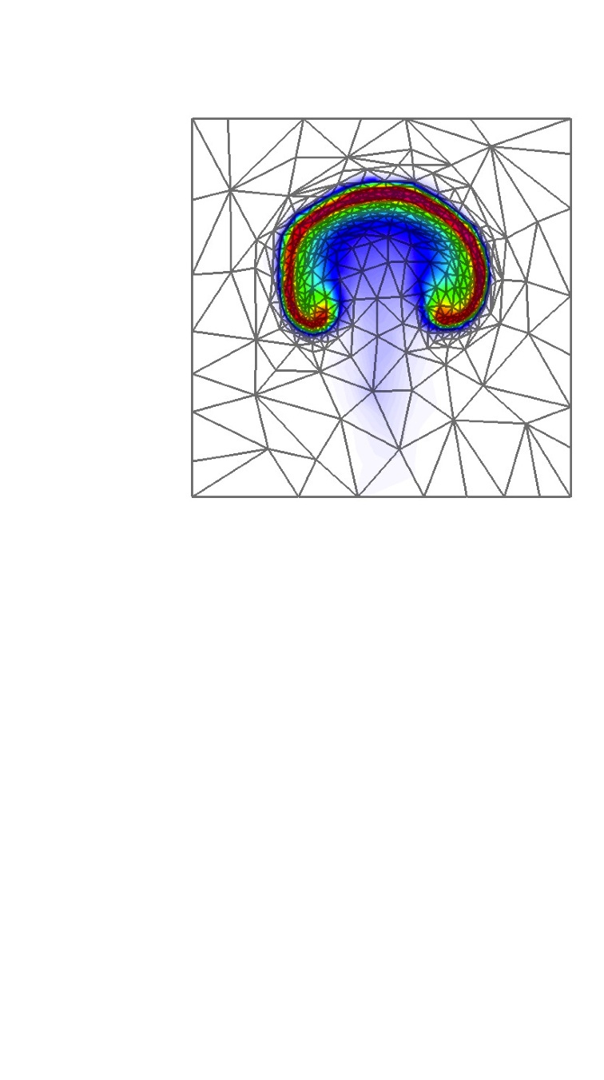
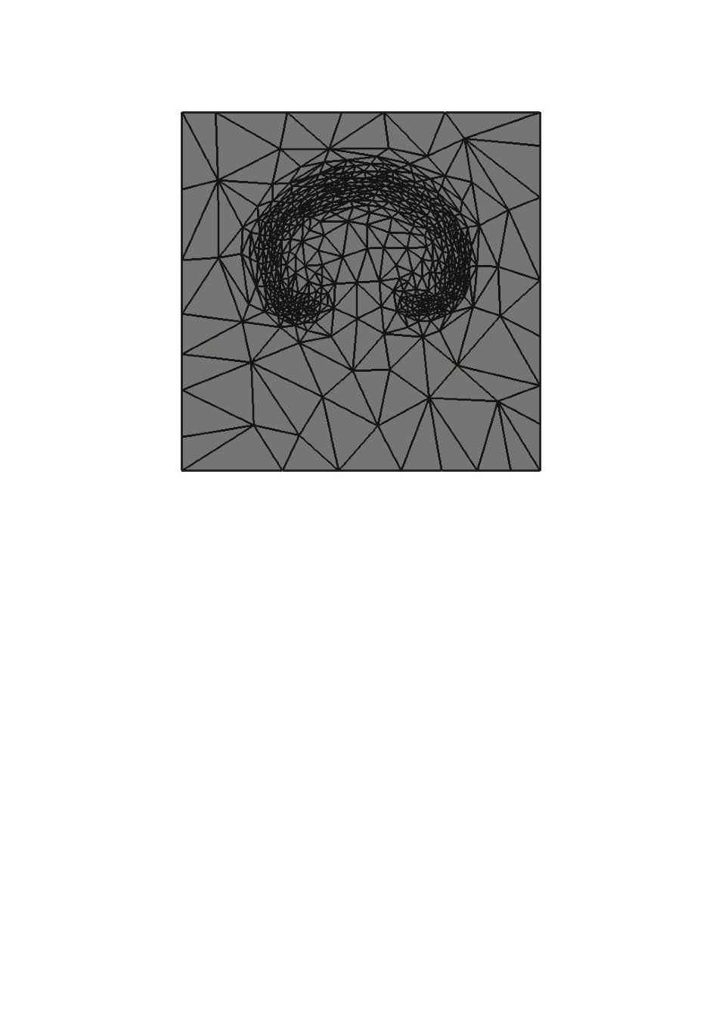
Current Methodology – mesh to mesh interpolation
Data on old mesh
Data on new mesh?
?
?
?
?
?

Slide 36
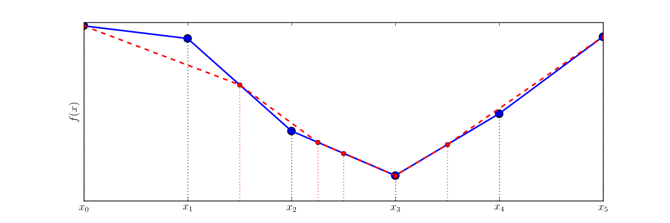
Interpolation – Method 1 “Consistent” Interpolation
Set values at new nodes to be spatial value on old finite element representation
Pros:
Cheap
Bounded
Gives original data
back if mesh doesn’t
change
Cons:
Nonconservative

Slide 37
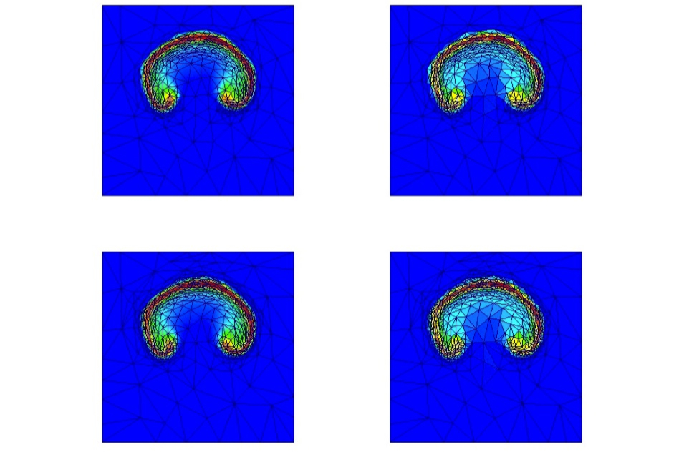
Interpolation – Method 2 - Grandy Interpolation
Average mesh data onto old elements as flat functions.
Calculate average on new elements
Project back to original shapes.
Pros:
Cheap(ish)
Bounded
Local
Cons:
Dissipative especially for discontinuous fields

Slide 38
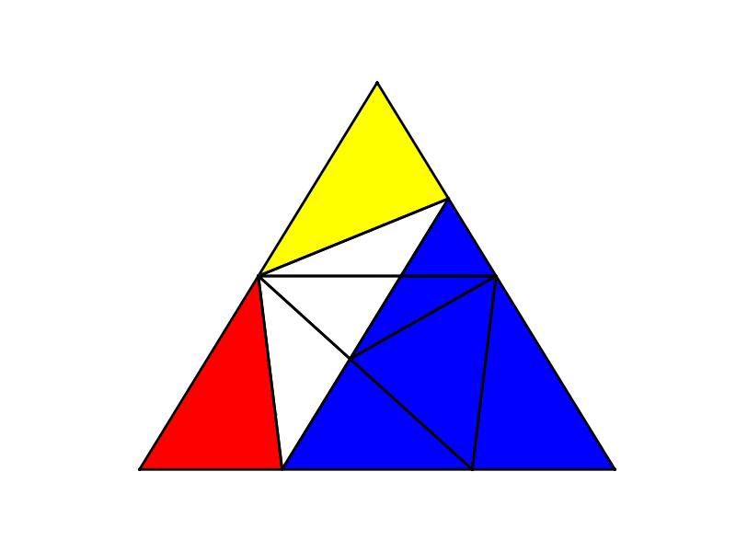
Supermeshing
FE solutions/test functions piecewise smooth over mesh elements
Elements of supermesh: old variables and new test fns both smooth.
No jumps.
Allows efficient conservative mesh to mesh interpolation via projection methods
P. E. Farrell & J. R. Maddison (2011)
Computer Methods in Applied
Mechanics and Engineering

Slide 39
Interpolation - Galerkin Projection
Galerkin Finite Element solution to
Right hand side is trickier
Supermeshing to the rescue!
Left hand side is usual mass matrix
Pros
Conservative
Local
Cons
No bounding
(more) expensive
Questions over control volumes

Slide 40
Discussion
Questions to the room:
What variables are worthwhile to adapt to?
Saturation? Pressure?
Do the length-scales inside the absolute permeability tensor matter?
Interpolation methods for control volumes in the fully discontinuous formulation

Slide 41
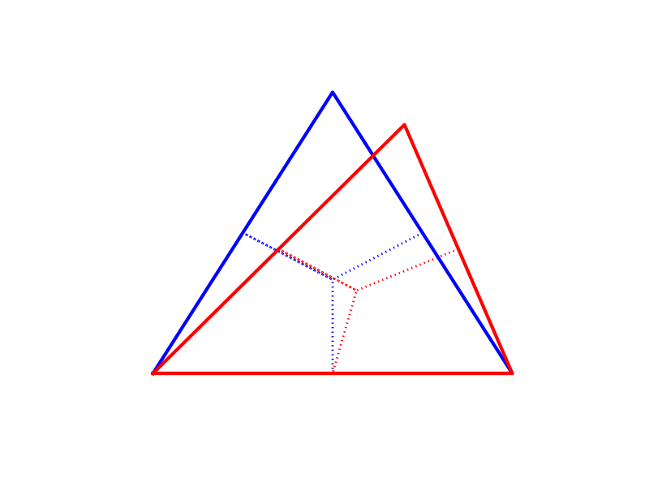
The issue with control volumes
Supermeshing is much easier with triangles/tetrahedra than with control volumes
Moving one node creates 3 triangles of overlap for FE
Moving one node creates 7 quadrilaterals and one triangles of overlap for CV

Slide 42
Discussion: Choice of Variables to adapt to
Buckley Leverett solution : Saturation

Slide 43
Discussion: Choice of Variables to adapt to
Buckley Leverett solution : Relative Permeability

Slide 44
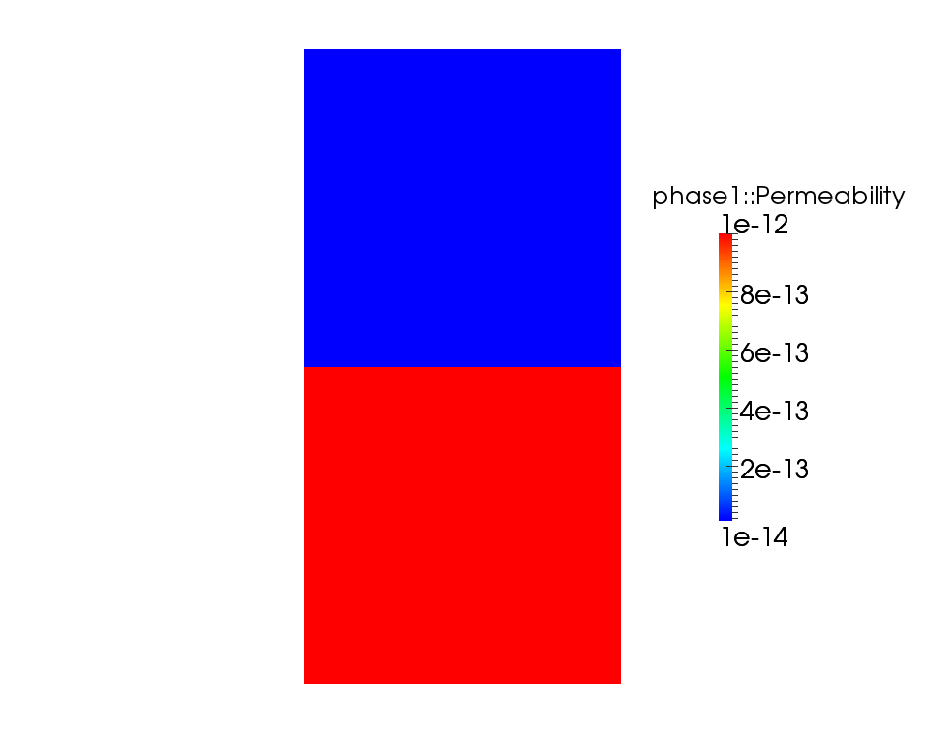
Discussion: Choice of Variables to adapt to
Velocity or pressure?
Single phase Darcy flow through two porous media
Prescribed pressure difference

Slide 45
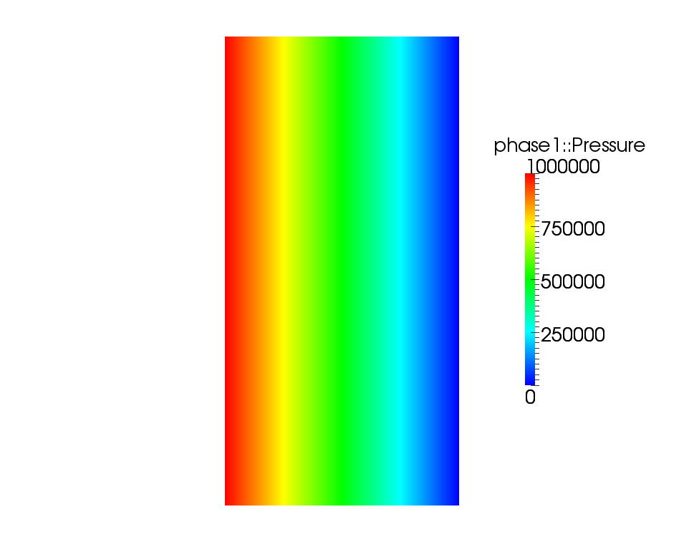
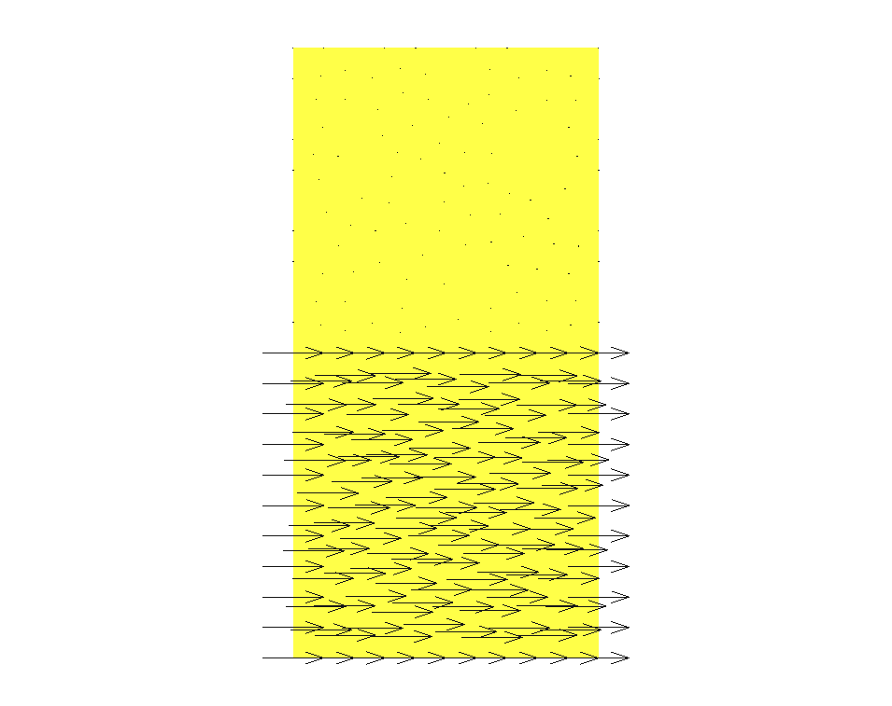
Discussion: Choice of Variables to adapt to
Velocity or pressure?
Velocity
Pressure

Slide 46
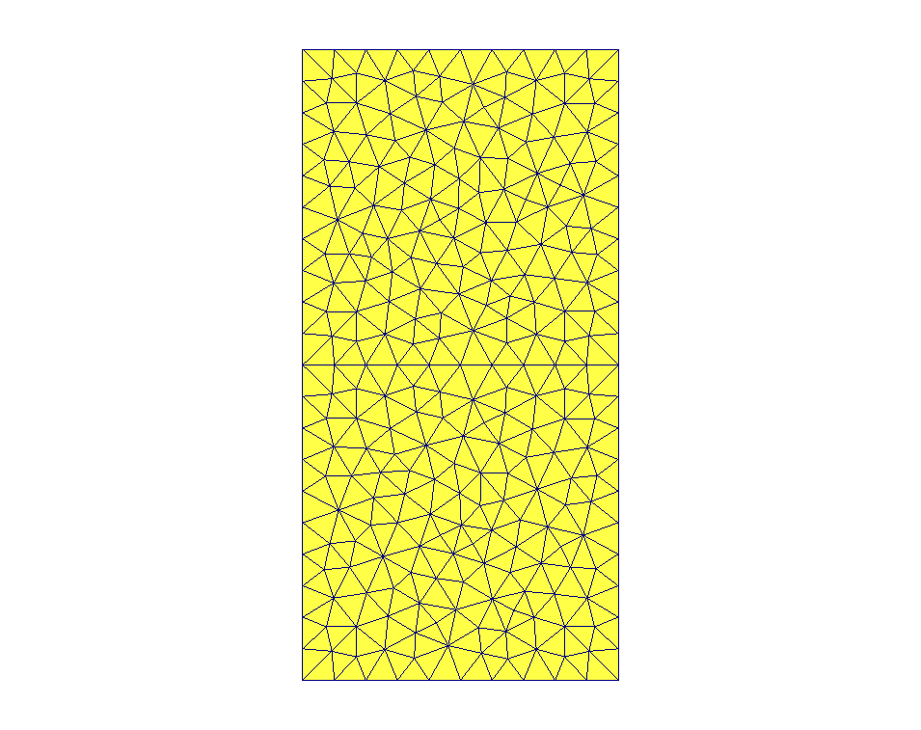
Discussion: Choice of Variables to adapt to
Velocity or pressure?
Velocity
Pressure

Slide 47
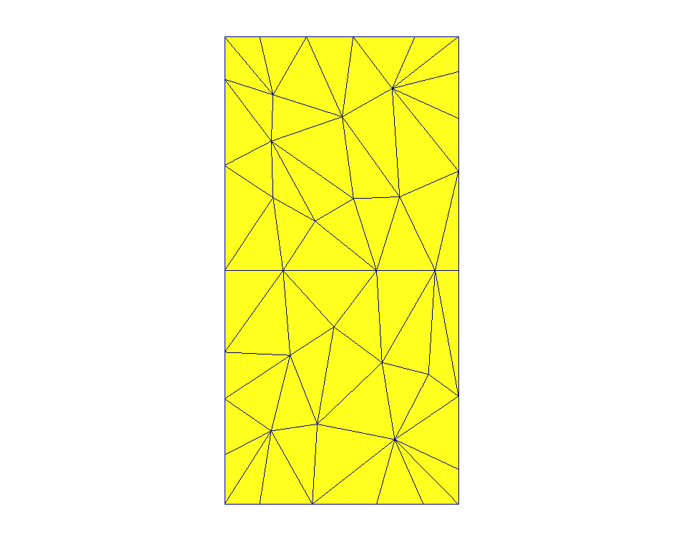
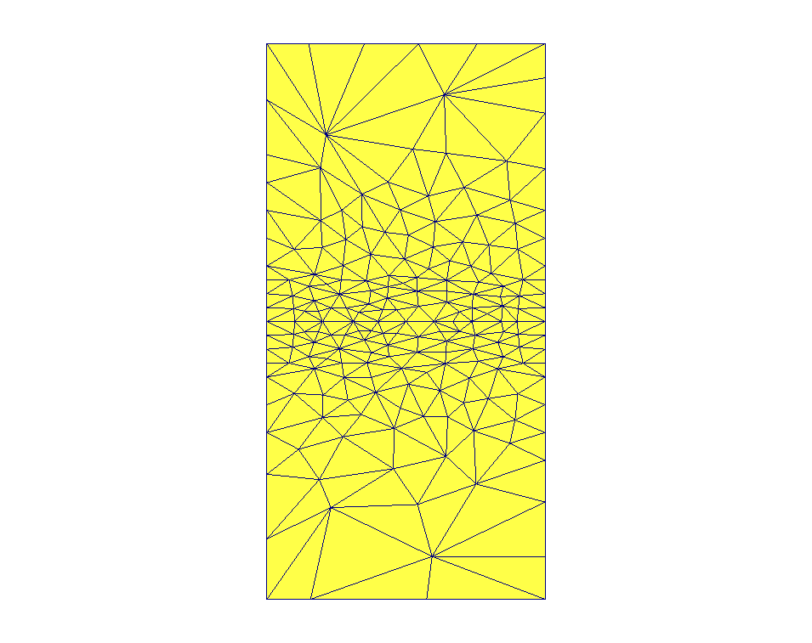
Discussion: Choice of Variables to adapt to
Velocity or pressure?
Velocity
Pressure

Slide 48
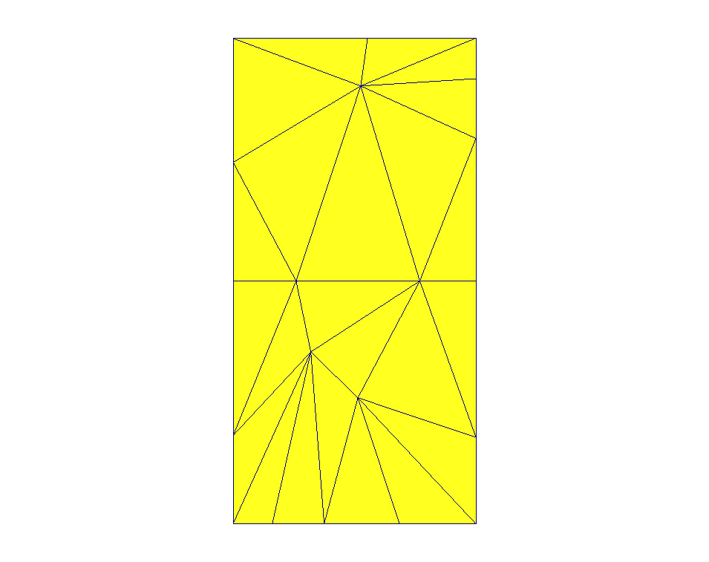
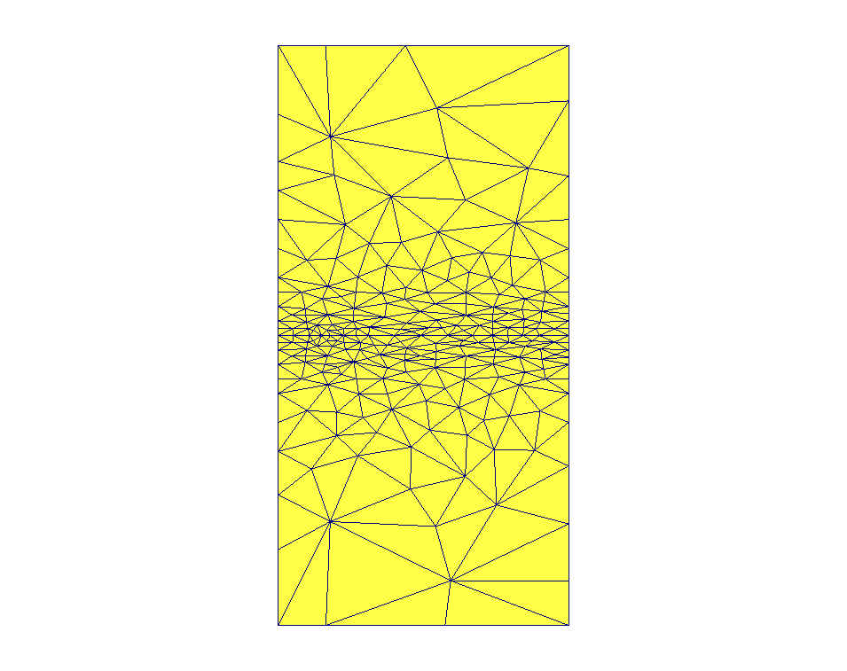
Discussion: Choice of Variables to adapt to
Velocity or pressure?
Velocity
Pressure

Slide 49
Any further points?
Thank you very much for your input
j.percival@imperial.ac.uk
Room 4.85 RSM

